Slide 1




File Transfer Tool And Store Creation
For
Cheers POS
When: 3.00-3.30 pm, Thursday, Dec 19
Where: DUE 2183
By Victor Ramos

Slide 2
Problem Statement
Transferring data from one point of sale to another is currently done manually
Cheers has access to store’s inventory data folders
There was no easy way to find the data needed from the store’s inventory data folder

Slide 3
Program Goals
Build a web application that can take store data and organize it in a database
When uploading the data, the application will clean the data and if possible fill in any missing data using Inventory Item Library
Every new store uploaded to application will create an ever growing Inventory Item Library
Inventory Item Library will only add new items that it has not seen before
Allow for the creation of a new store using the items in the Inventory Item Library

Slide 4
Features
User can upload a store csv and application will gather item data
Items missing distributors will not be added to new store
Cleaned dirty data
Any items with errors will be highlighted in red
User can create a store with Item Inventory Data
Application will auto add new Distributors, Categories, and Sizes
User can edit store data
User can download store data as a csv
User can add more Item Inventory Date items

Slide 5
Problems Faced During Development
Original idea was to pass store folder to website. However, store data can be very large. I didn’t know websites didn’t have access to the users folder system.
Organizing retail data can be confusing
Items can have the same SKU# but be from different Distributors
Items can have the same UPC# but have different SKU#. Example, a holiday item and a non-holiday item
Most of these problems were solved during development except store folder access.
Application accepts csv files

Slide 6
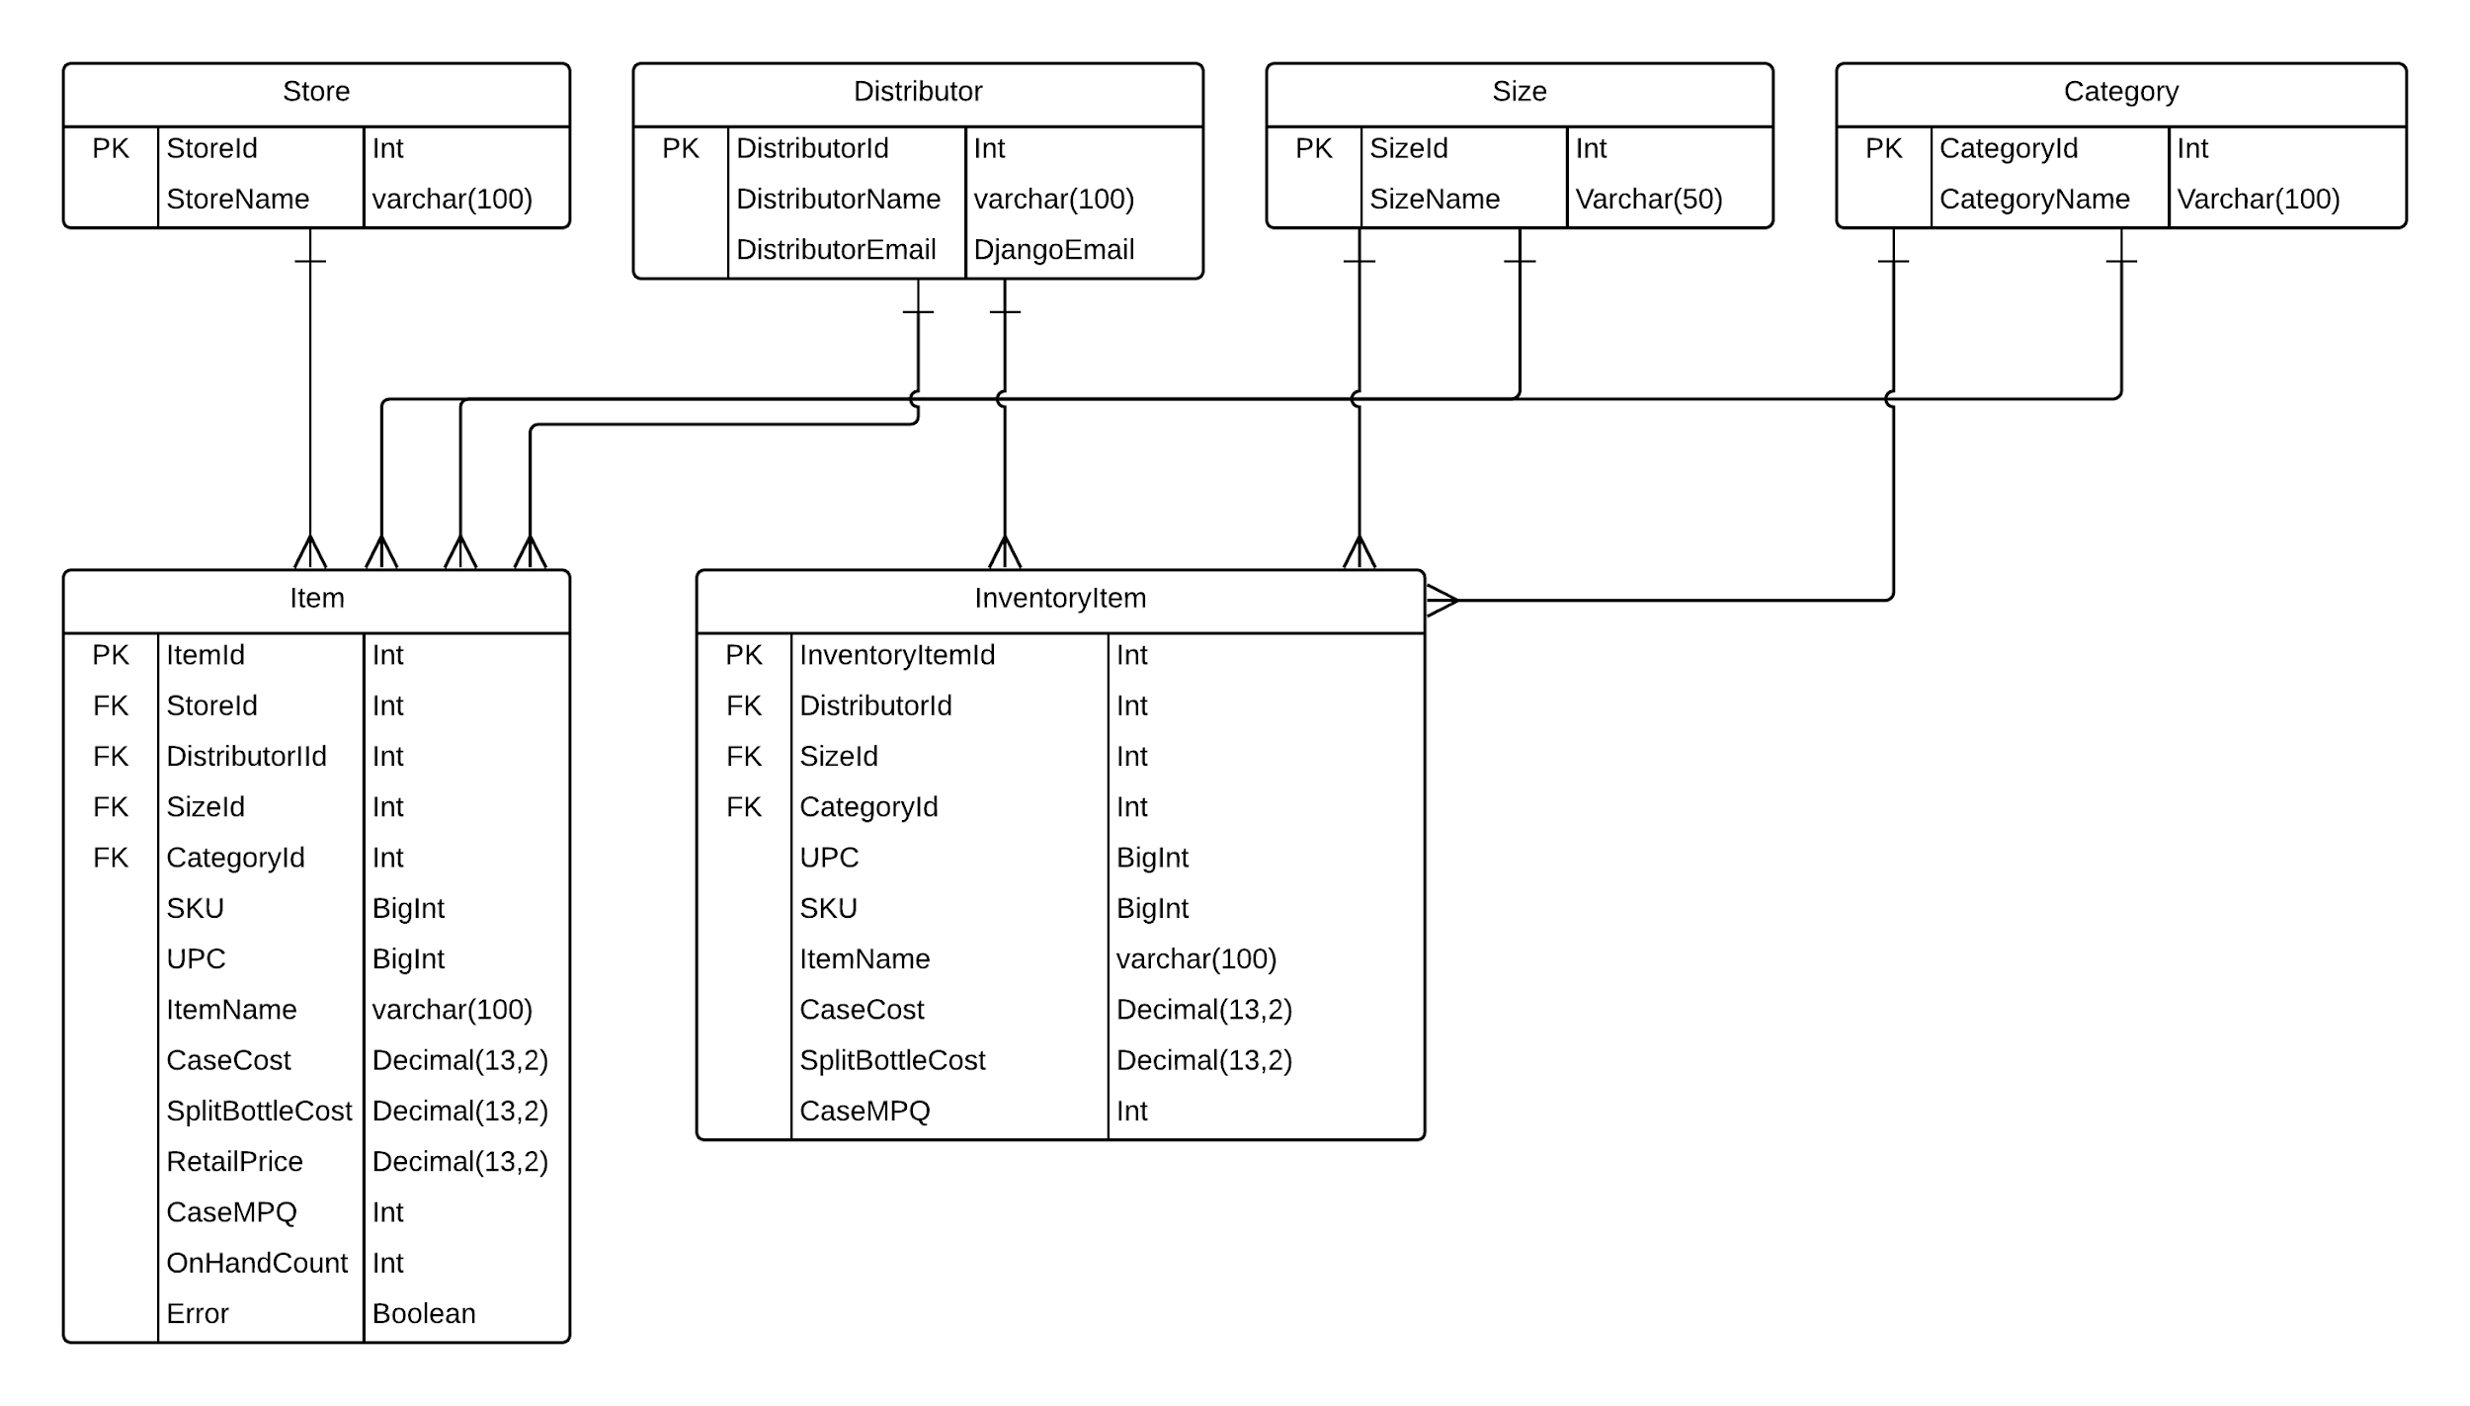
Database Design

Slide 7





Tools

Slide 8
Python Libraries Used
Pandas
MySQLClient
Django
Django-cors-header (used to get rid of some local host access deficiencies)

Slide 9
Development Schedule
September: Present Idea to Advisor
October: Figure out database design and study store folder structure, begin website creation
November: Create database models, implement store transfer, implement store creator
December: Beautify website and present

Slide 10
Problems Faced During Development
No experience in website creation/django
Store folders couldn’t be uploaded to database. Uploading folders requires extra database storage and good internet from user
Create a store was a problem as I had to use Ajax and I have never used it before
Ran into problems with CSRF tokens
Datatables performance is abysmal. I could improve it using Ajax but I need to do more research

Slide 11
Future Work
Create a tkinter application to access user store folder
Upload tkinter application to website so user can download it and use it
Deploy website using Amazon Lambda
Increase application performance
Make website prettier
Learn more about web development

Slide 12
Questions and Demo

